Slide 1

冒險故事
Animaze

Slide 2

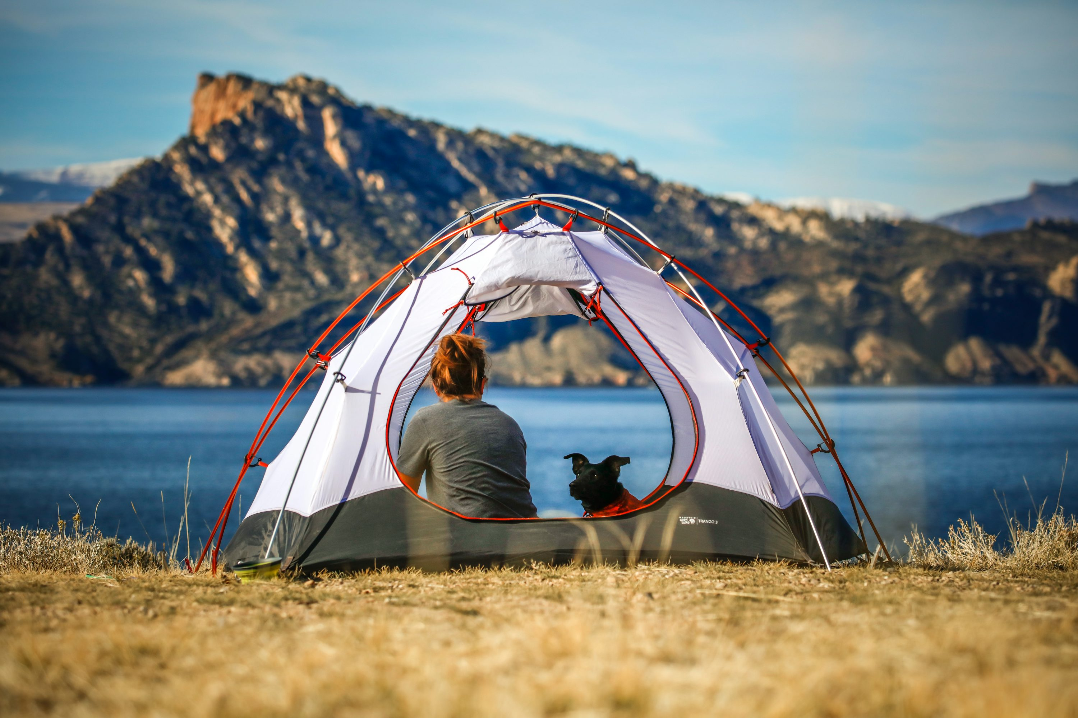

目標
Notes:
https://unsplash.com/photos/woman-and-a-dog-inside-outdoor-tent-near-body-of-water-eDgUyGu93Yw

Slide 3
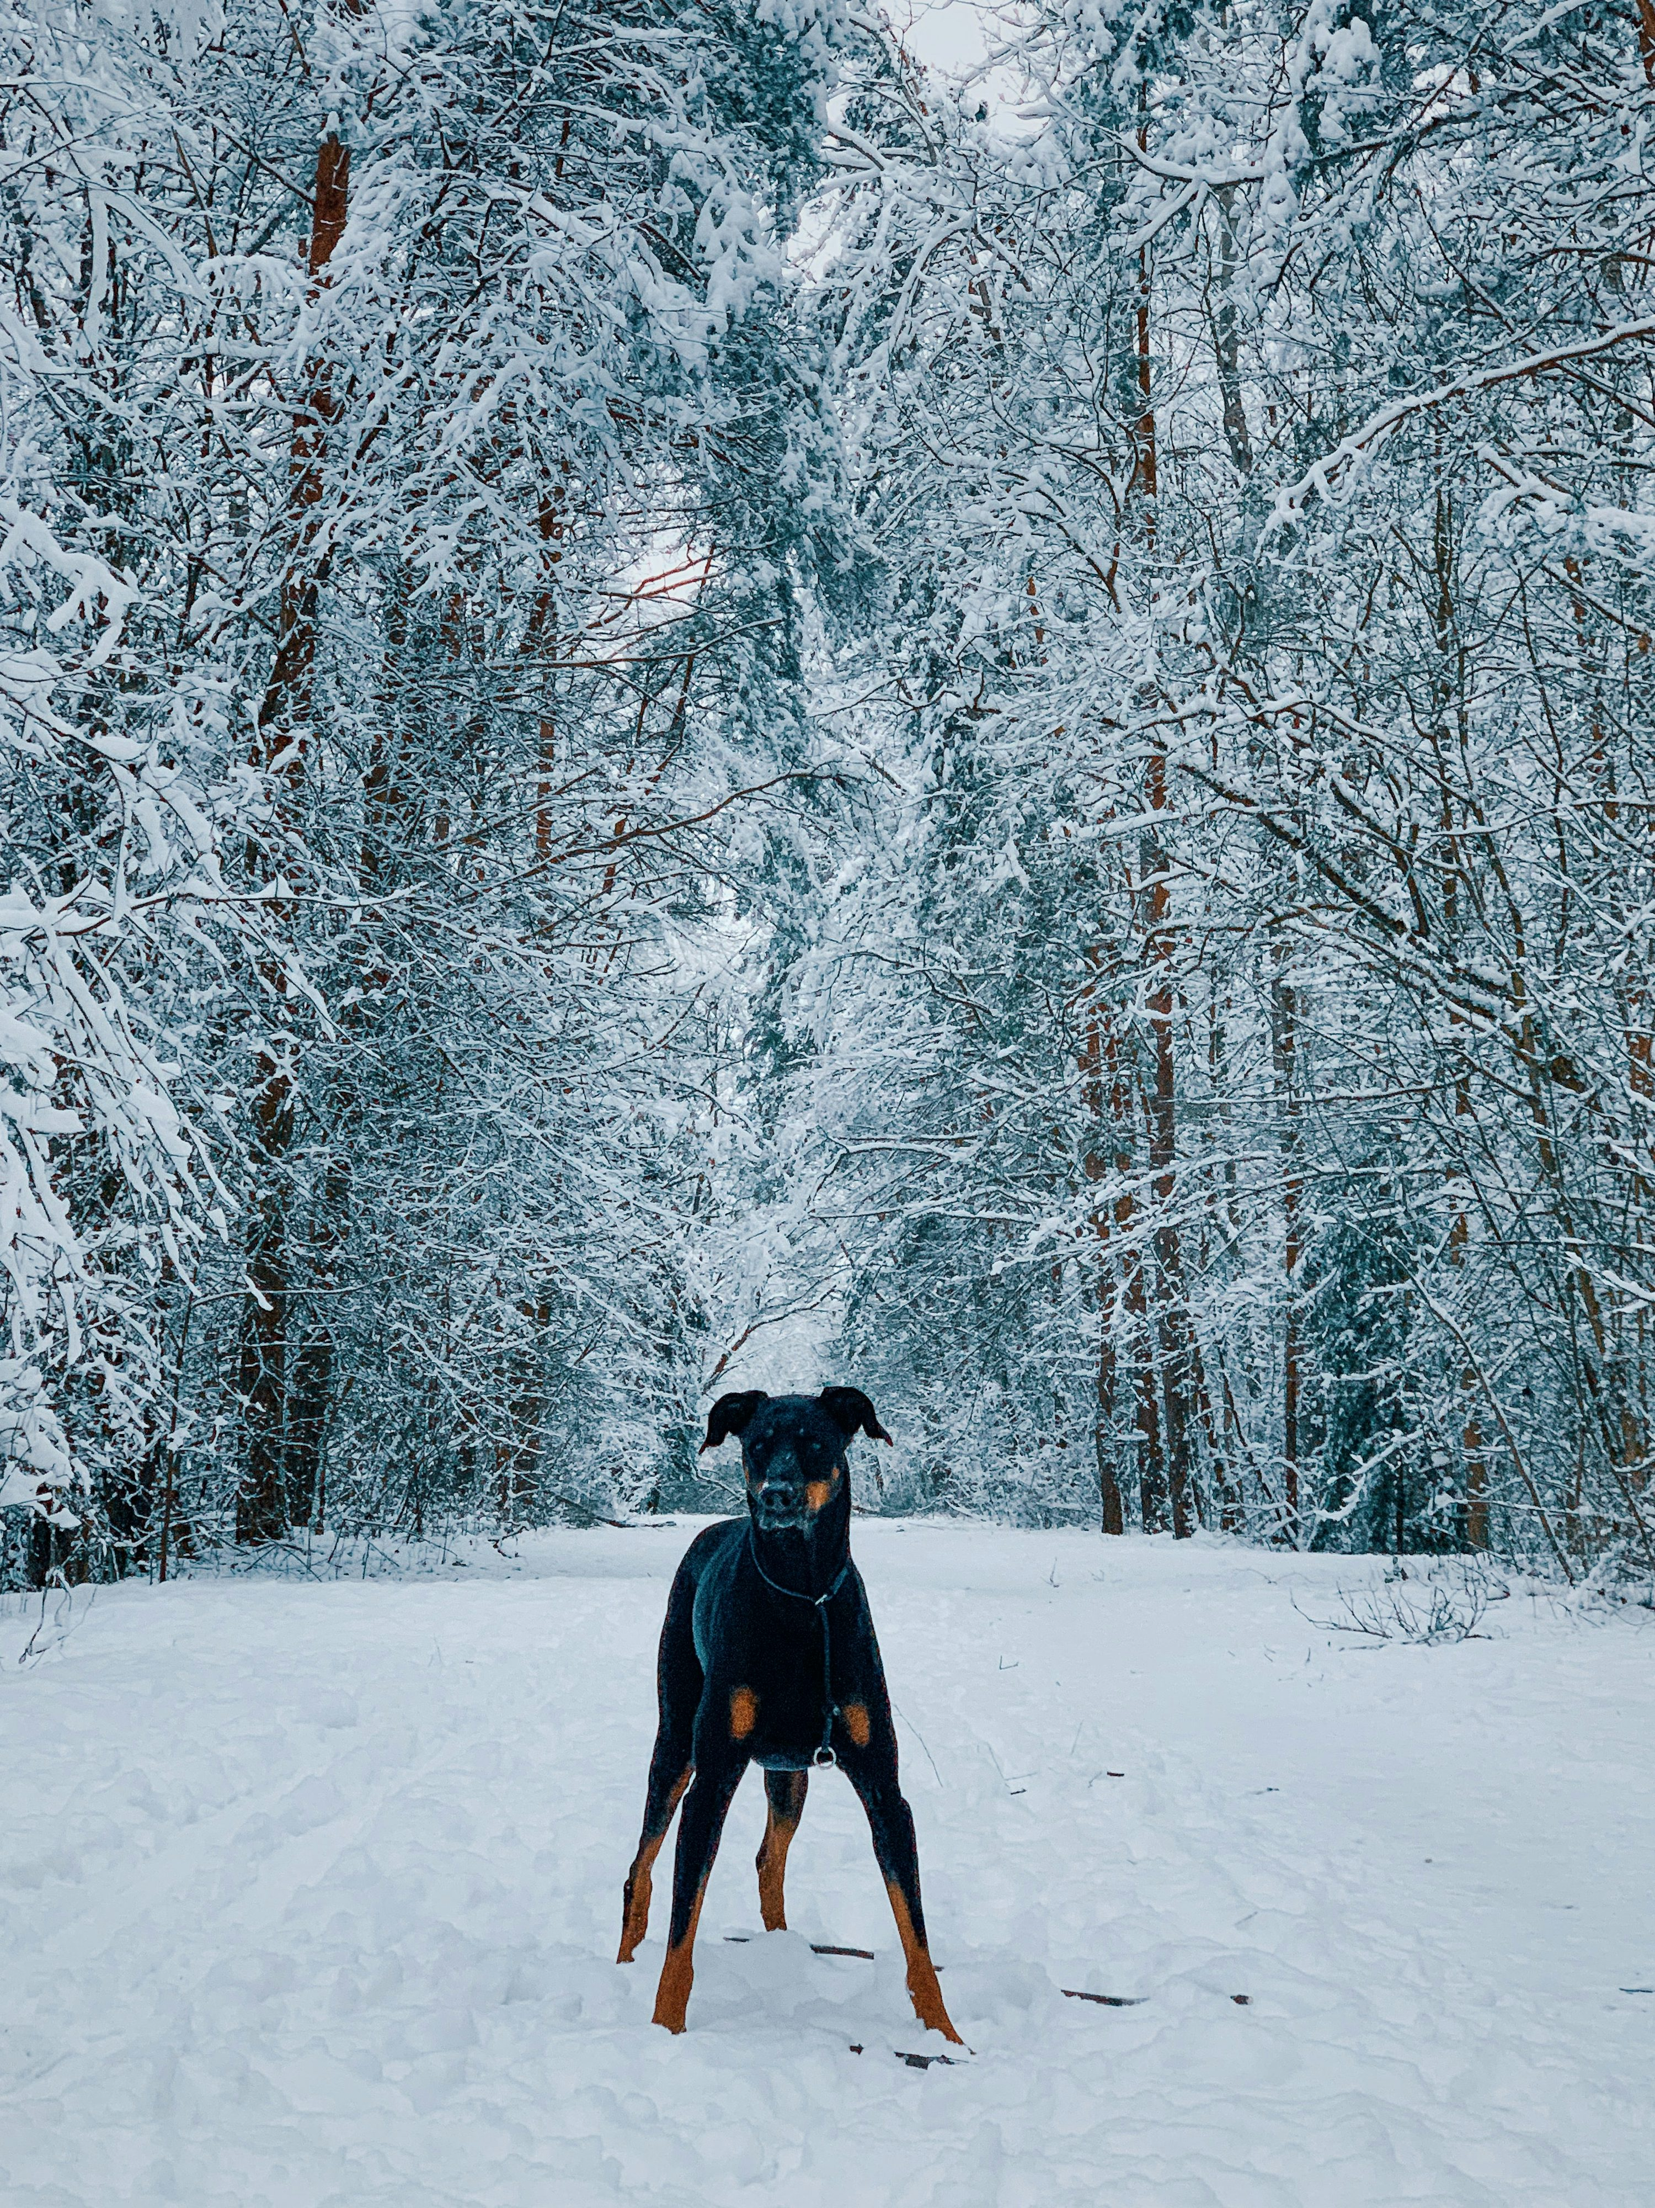
阻礙
Notes:
https://unsplash.com/photos/black-and-tan-short-coat-medium-dog-on-snow-covered-ground-near-trees-during-daytime-pbf3j_MnvSo

Slide 4
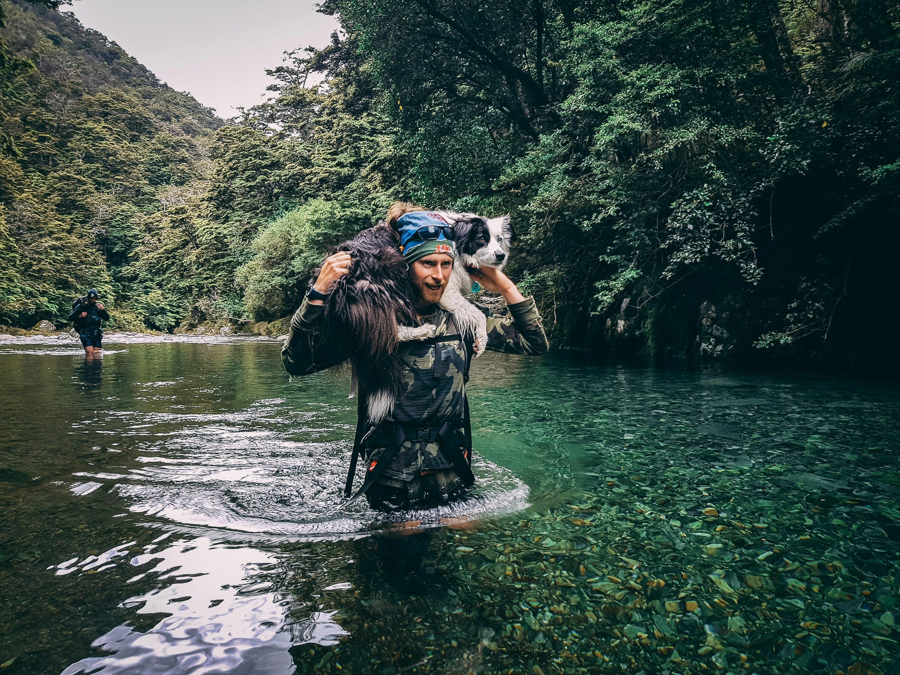
努力
Notes:
https://unsplash.com/photos/a-woman-is-wading-through-a-river-with-a-dog-on-her-back-WOHMB85sLM0

Slide 5
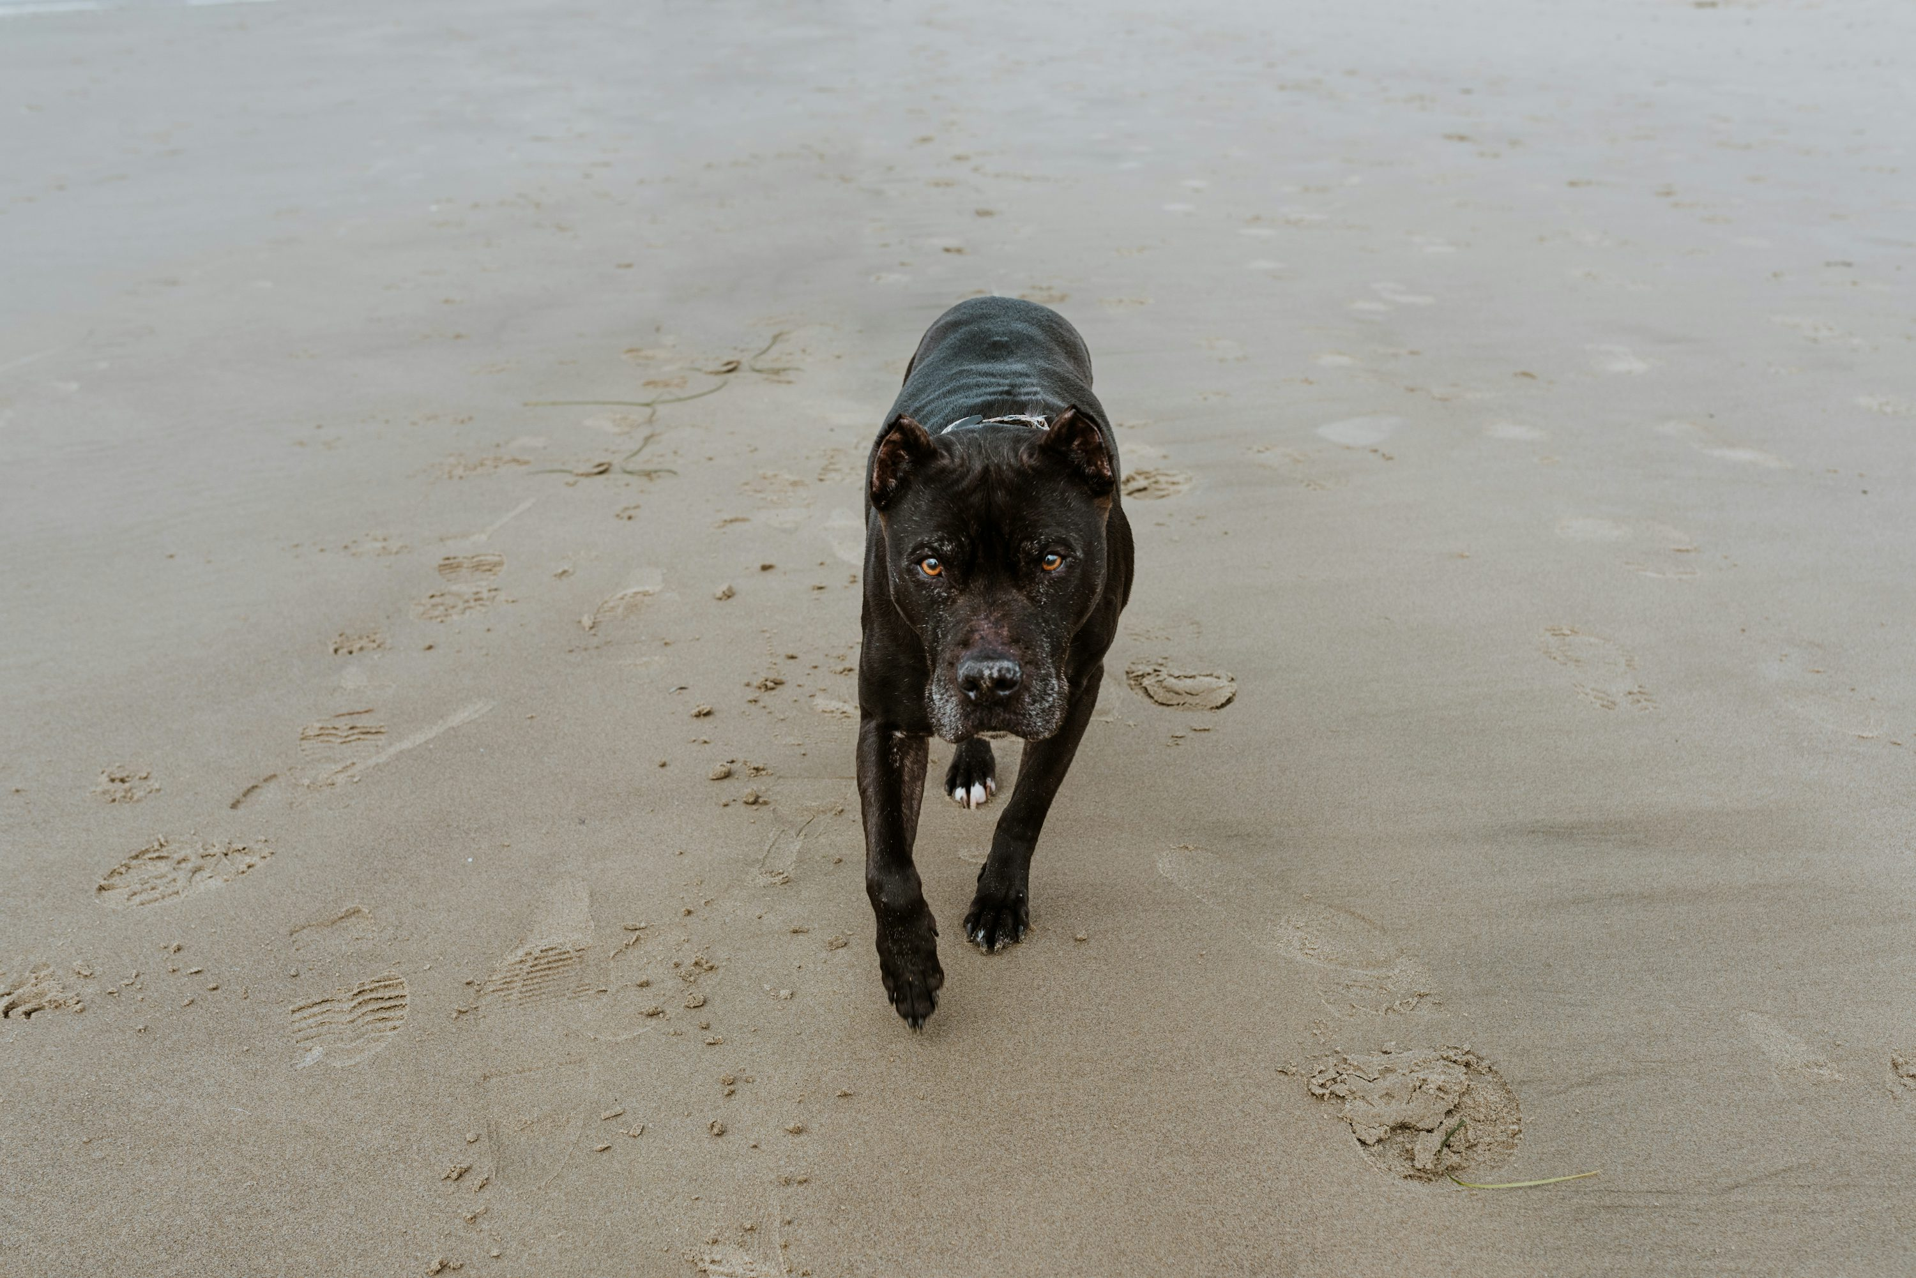
結果
Notes:
https://unsplash.com/photos/a-black-dog-walking-across-a-sandy-beach-8iDG0gMirWw

Slide 6
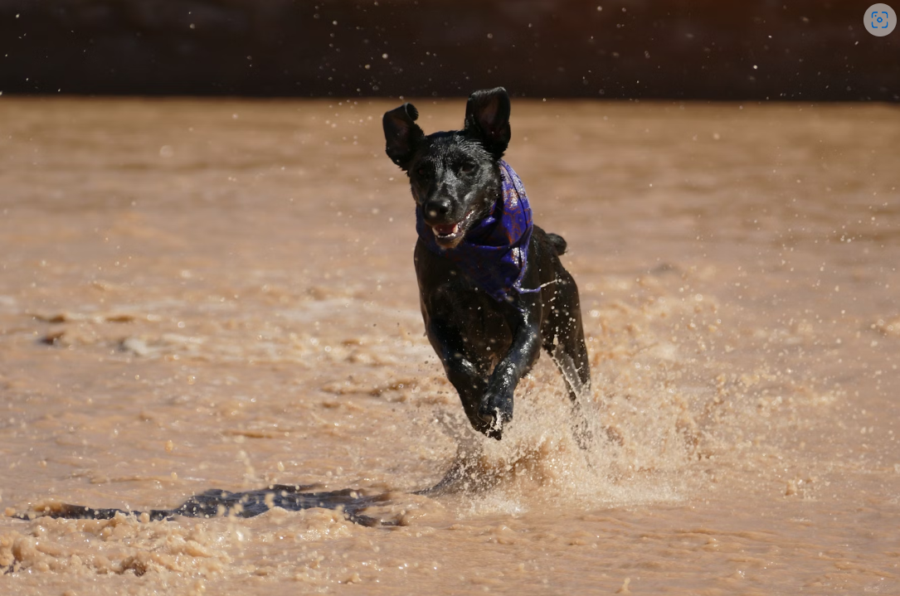
意外
Notes:
https://unsplash.com/photos/dog-running-on-flooded-land-7EKROB9iGFc

Slide 7
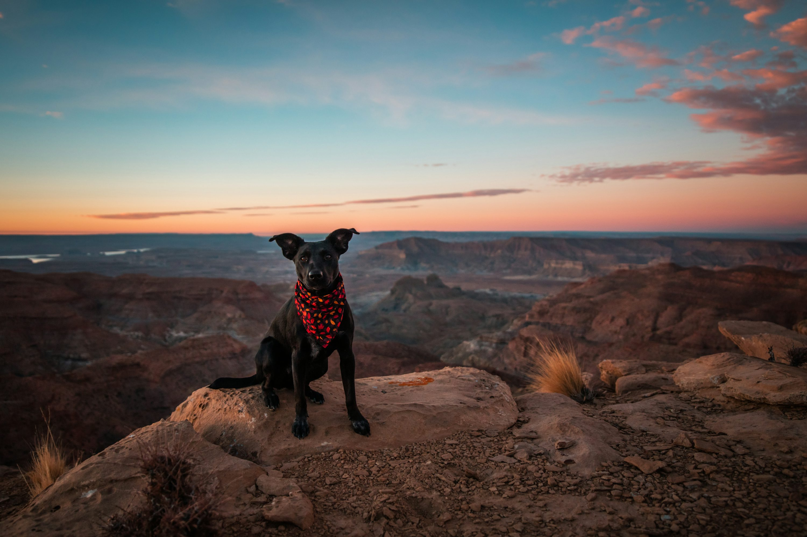
轉彎
Notes:
https://unsplash.com/photos/short-coated-black-dog-sitting-on-rock-remPwE2zZus

Slide 8
結局
Notes:
https://unsplash.com/photos/black-and-tan-short-coat-medium-dog-on-snow-covered-ground-near-trees-during-daytime-pbf3j_MnvSo

